Slide 1
Making this resource work for you
Prior to teaching this lesson, please refer to the ‘Unit Overview and Planning Document’.
Further guidance on planning Science Mastery lessons can be found in the detailed planning guidance document.
Refer to the ‘notes’ section on each slide for useful information, including suggested expositions, pedagogical content knowledge, suggested questions, answers and more. Consider using presenter mode so you can see this guidance throughout the lesson.
The introduction slides can be adapted to suit your teaching style and the needs of your class.
Before the lesson, adapt the fix-it slide to address any misconceptions identified in the previous lesson’s exit ticket.
Choose from the suggested activities to suit your class. The intention is not that you complete all of these, but that you select those which ones are most appropriate for your students. It may be appropriate to further adapt activities for your students.
These lessons are designed to occupy approximately 1 hour. To adapt for a shorter or longer lesson duration we advise you to adapt the activity section accordingly.
Please consider using the final slide to send feedback about this lesson or examples of PowerPoints that you have adapted to our design team. Your feedback is used to improve Science Mastery for all of our teachers and students. We appreciate all suggestions and comments.
Thank you for reading!
The Science Mastery Team

Slide 2
Density
Answer the questions below.
Put the states of matter in order of increasing internal energy.
In which state of matter are particles held most tightly together?
Compare the arrangement of of particles in liquids and gases.
Define internal energy.
Name a piece of apparatus that can be used to measure the volume of a liquid.
Solid→ liquid → gas
Solid
Particles in a liquid are held close together in an irregular arrangement but particles in a gas are spread randomly.
The sum of all the kinetic and potential energy of all the particles in a system.
Measuring cylinder, pipette, beaker
Notes:
Big idea: Energy is conserved
Foundation: Which state(s) of matter can be compressed?
Stretch: Explain why this state of matter can be compressed but others cannot.
Answers:
Foundation: Gas
Stretch: Gases can be compressed because there is space between particles, but liquids and solids cannot be compressed because there are no spaces between particles.

Slide 3
Density
Do Now:
Put the states of matter in order of increasing internal energy.
In which state of matter are particles held most tightly together?
Compare the arrangement of of particles in liquids and gases.
Define internal energy.
Name a piece of apparatus that can be used to measure the volume of a liquid.
Drill:
State the formula to calculate the volume of a cube.
Calculate the volume of a cube with sides of length 4 cm.
Calculate the surface area of the cube in Q2.
Notes:
Drill answers
V=lbh
V = 64 cm³
SA = 96 cm²

Slide 4
Density
Read Now:
Matter makes up everything, and matter is made of atoms. Atoms can exist individually or as part of compounds or molecules. When we talk about matter, we can describe all these different arrangements of atoms as ‘particles’. Density is a fundamental property of matter. It describes how close together the particles are, specifically the mass of particles within a given volume. The SI unit for mass is the kilogram, but often in chemistry the masses we work with are so small that we can use the gram.
Explain what matter is made of.
Define density.
State the SI unit of mass.
Identify which state of matter is the most dense.
How many grams are in 1 kg?

Slide 5
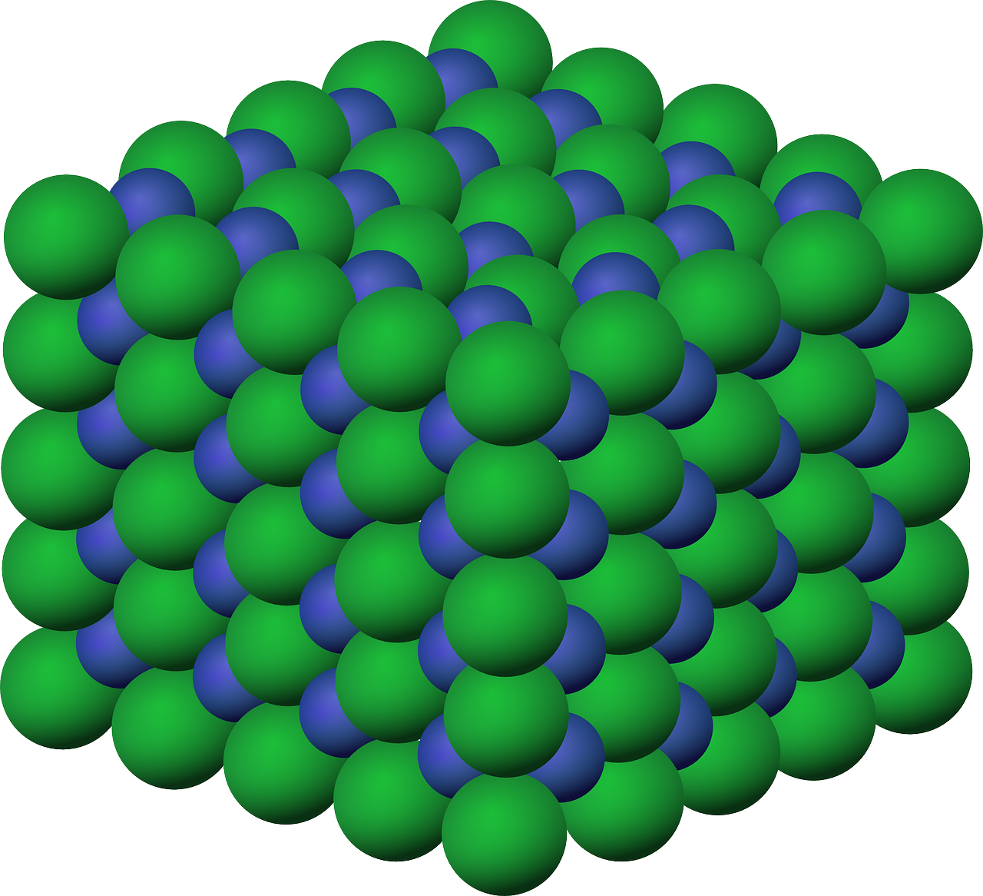
P4.1.2
03/02/2025
Density
P4.1.1 Prior Knowledge Review
P4.1.2 Density
P4.1.3 Measuring Density
P4.1.4 Gas Pressure
P4.1.5 Taking it Further: Pressure
P4.1.6 Taking it Further: Pressure in Fluids
Notes:
Big Idea: Energy is Conserved.
Students have covered density in C1.1. This lesson will review the idea of density and how to calculate it before applying it to more complex scenarios.
Suggested Hook:
Show students two pieces of material that have the same volume, such as a piece of wood and a piece of metal.
What would happen if we put both of these pieces in water? Why?

Slide 6

Following this lesson, students will be able to:
Define density
Calculate the density of regularly shaped solids
Compare the density of objects with the same mass or the same volume
Key Words:
density
mass
volume
regular
Notes:
Guidance:
See unit overview document and planning guidance to see how these objectives are typically assessed at GCSE, including examples of what students should be able to do following this lesson.
Planning for different needs:
The learning objectives given on this slide are suggested based on the most common requirements for exams, however they can be adapted based on the needs of different classes.
For best practice, the unit preparation booklet should be used to determine the appropriate focus of lessons within the unit.
While it is not possible to explicitly split content into levelled grades, we recommend that lesson objectives can be classified as critical, core or stretch.
Critical: the content or skill is essential for all students to be able to progress.
Core: the content or skill is important for students to progress, but other opportunities may be available to revisit it.
Stretch: the content or skill may not be essential for all students but is important for students aiming for the highest grades.
Key skill: this is a crucial skill being developed in this unit as part of the skill mapping
P4.1.2 Lesson Objectives:
Critical: Define density
Critical: Calculate the density of regularly shaped solids
Critical: Compare the density of objects with the same mass or the same volume

Slide 7
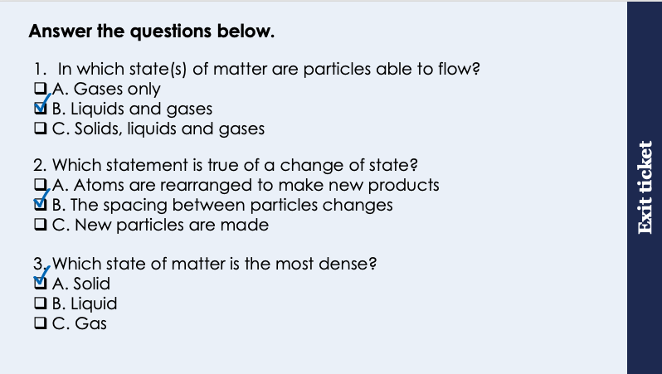
This is the fix-it portion of the lesson
The fix-it is an opportunity to respond to gaps in knowledge, especially those identified by the previous lesson’s exit ticket.
The teacher should customise this slide as needed, to facilitate
reteach, explanation, demonstration or modelling of ideas and concepts that students have not yet grasped or have misunderstood.
practise answering specific questions or of key skills.
redrafting or improving previous work.
Notes:
Purpose: to spend time on any gaps identified in previous learning from exit ticket feedback.
Fix-it guidance from previous exit ticket:
Q1. Answer: B
If students answer A, they recognise that particles in a gas can flow, but have not recognised that particles in a liquid can also flow. This is a crucial definition of a fluid for students to understand before they cover pressure in fluids. To fix-it, it may be useful to get students to complete a table of the properties of the states of matter.
Q2. Answer: B
If students answer A, they are not clear on the difference between physical changes and chemical reaction. If students answer C, they have not understood that the particles themselves are not altered during a change of state. To fix-it, review the differences between chemical changes and physical changes.
Q3. Answer: A
If students answer B or C, they may not be secure on the meaning of density. To fix-it, review the arrangement of particles in each state of matter. Density will be reviewed in more detail in the next lesson.

Slide 8
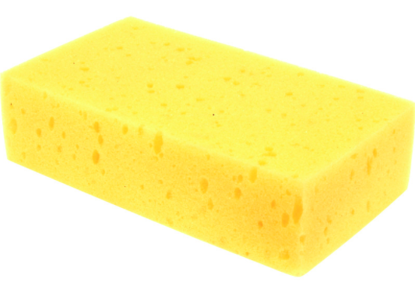
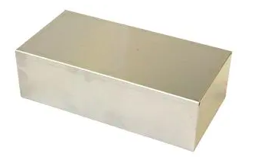
Float or sink?
These items take up the same amount of space. They have the same volume.
Would you expect them both to sink or float in water?
Why is this? Clue: Sketch a particle diagrams for each item.
Metal
Sponge
Notes:
Suggested teacher exposition:
Look at these two items. Hold up metal and sponge cut to the same size, or alternative materials. You can see they are the same size. They take up the same amount of space. They have the same....ask a student to suggest a scientific word to finish your sentence. Volume. For each of these items, draw now what you think the particle diagram should look like. Display particle diagrams. You can see they are both solids. Both have particles lined up in a regular structure. They can't flow over each other like they would in a liquid. But the sponge has less particles in the same amount of space. There's more air. Sometimes this is because the particles is a substance are bigger, so the gaps in between have more empty space. Draw two different particle diagrams on the board, one with very large particles and one with very small particles. Share in the space between. Now look at how much empty space there is in this diagram compared to this diagram.
Image source: Pexels

Slide 9
Density
The density of an object is the mass per unit volume.
This means how much matter (particles) is packed into a certain volume.
Metal
Sponge
Higher density:
More particles in a given volume
Lower density:
Fewer particles in a given volume
Notes:
Suggested teacher exposition:
The metal has more mass (or matter, or stuff) packed into this amount of space Hold up the metal. Or more correctly, packed into this volume. The sponge has less mass per unit volume. That is how we say it – we talk about the mass per unit volume. A greater mass per unit volume means the substance is more dense. Less mass per unit volume means the substance is less dense.
Teacher guidance:
This description of density is a simplified one, suitable for Y7 students. A more technically correct definition will be introduced later, before pupils have to calculate density using mass and volume.

Slide 10
Calculating Density
This is an equation you will need to remember.
In order to calculate the density of an object, we need to know its mass and volume.
Mass (m) is measured in kilograms (g).
Volume (V) is measured in metres cubed (m³).
𝜌 = m
V
Mass
measured in (kg)
Density
measured in (kg/m³)
Volume
measured in (m³)
Notes:
Additional teacher information: The symbol used to represent density looks like a small ‘p’, and can be written as such. It is actually the Greek letter ‘rho’. In statistics, this letter is used to represent population correlation. In Physics, the letter is the standard representation for density.
Note for teachers: kg/m³ can also be written as kg m⁻³.
Suggested teacher exposition:
We can calculate the density of a substance or an object very easily once we know its mass and its volume. We just take the mass and divide by volume and that gives us the density. We just make sure that the mass is in kilograms, and the volume in m3 - that’s cubed with a small 3 up high. We represent density with this symbol here that looks like a lowercase p – its actually a Greek letter called 'rho'. This is the unit we use for density. Remember if you ever see a number with this unit after it, that number is telling you the density of something.

Slide 11
Calculating Density
A block of metal has a mass of 12 kg. The volume of the block is 0.002 m³. Calculate the density of the block.
Answer:
Mass: 12 kg
Volume: 0.002 m³.
𝜌 = m
v
𝜌 = 12
0.002
𝜌 = 6000 kg/m³
Notes:
Note for teachers: kg/m³ can also be written as kg m⁻³.
Further question:
If I had a block that was 1m3 in volume, what would its mass be?
6000 kg.
We can also use g and cm3 as units for mass and volume, depending on the size of the object, as this can often give us more precise results.
How would the volume of this cube have been calculated?
V = lbh.
We can use this formula for a regularly shaped solid, such as a cube or cuboid.
Stretch:
How could we calculate the volume of a cylinder? Or a sphere?
Cylinder: Area of the end ($πr^{2})$ x length
Sphere: V=$\frac{4}{3}πr^{3}$

Slide 12
Comparing Density
Metal
Sponge
The metal block has a density of 6000 kg/m³.
Would you expect the density of the sponge to be greater or less than 6000 kg/m³?
What would you expect when you compared the mass of the two objects?
Notes:
Suggested teacher exposition:
So we’ve used the equation to calculate

Slide 13
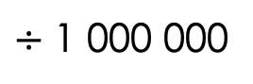
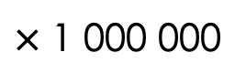
Converting between cm³ and m³
How many cm are there in 1 m?
100
What is the volume of this shape in cm³?
30 cm
30 x 10 x 8
= 2400 cm³
What is the volume of this shape in m³?
Convert each length into m first
0.3 x 0.1 x 0.08
= 0.0024 m³
8 cm
10 cm
$÷$ 1 000 000
2400/0.0024 = 1 000 000
This factors in the conversion of the three quantities.
cm³
m³
$×$ 1 000 000

Slide 14




Which statements do you agree with?
To calculate density, use the weight and volume of an object
Density is a measure of how heavy something is
Density is a measure of how closely packed particles are
Density = mass x volume
Notes:
Suggested points:
Blue: incorrect. This is a confusion between density and mass/weight.
Yellow: incorrect. Mass not weight.
Green: correct.
Pink: incorrect. Density = mass/volume
Suggested guidance:
Talk tasks can be used in a variety of ways to suit the particular needs of the students you are teaching. Through exchanging views with others, students develop their understanding of the science beyond what could be achieved individually.
Science classrooms that successfully integrate talk have the following features:
Science talk is a regular feature of lessons and is woven into classroom activities.
Students are paired or grouped strategically by the teacher to ensure productive interaction. This might take into consideration the students’ proficiency of the English language, how encouraging they might be to peers and their attainment in the topic. It’s a good idea to consider these pairings in the class seating plan.
Students are encouraged and supported to talk, but are not forced to talk.
The teacher should take on the role of a facilitator, engaging with conversations where necessary and encouraging or steering the conversation where needed.
Students are encouraged to use the language they have to express their ideas (e.g., everyday language, imperfect English, native language), but also to incorporate science specific terminology where this is more accurate or has been taught.
6. Scientifically inaccurate ideas are not dismissed by the partner or teacher; open discussion and further investigation are relied on to help students construct ideas that support them to progress in their scientific understanding.
7. Guidelines for behaviour during talk tasks are explicit and frequently reviewed. Rules for students might be:
Listen carefully to your partner
Take turns talking.
Speak one at a time, without interrupting.
Politely agree or disagree and explain why.
Politely point out if your partner has used a scientific word incorrectly, if they have explained the science incorrectly, or if there is a more accurate way to describe something.
If confused, ask questions.
Stay focused on the discussion topic.
Respond to one another.

Slide 15
Comparing Density
These three cubes are made of different materials.
They all have the same mass.
What can be said about the density of these cubes?
Describe a method you could use to calculate the density of each.
B
A
C
Stretch:
If all the cubes had the same density, what would you expect to note of their masses?
Notes:
Suggested points:
The cube with the smallest volume will have the greatest density (and vice versa)
This has the same number of particles (the mass) in the smallest volume, so they are most closely packed together.
Measure the mass of each using a balance.
Measure the length, breadth and width of each cube to calculate volume.
Density = mass/volume
Stretch:
If they all had the same density, they would all have different masses. The cube with the largest volume would have the largest mass.
You may want to show students this using model answers.
Suggested guidance:
Talk tasks can be used in a variety of ways to suit the particular needs of the students you are teaching. Through exchanging views with others, students develop their understanding of the science beyond what could be achieved individually.
Science classrooms that successfully integrate talk have the following features:
Science talk is a regular feature of lessons and is woven into classroom activities.
Students are paired or grouped strategically by the teacher to ensure productive interaction. This might take into consideration the students’ proficiency of the English language, how encouraging they might be to peers and their attainment in the topic. It’s a good idea to consider these pairings in the class seating plan.
Students are encouraged and supported to talk, but are not forced to talk.
The teacher should take on the role of a facilitator, engaging with conversations where necessary and encouraging or steering the conversation where needed.
Students are encouraged to use the language they have to express their ideas (e.g., everyday language, imperfect English, native language), but also to incorporate science specific terminology where this is more accurate or has been taught.
6. Scientifically inaccurate ideas are not dismissed by the partner or teacher; open discussion and further investigation are relied on to help students construct ideas that support them to progress in their scientific understanding.
7. Guidelines for behaviour during talk tasks are explicit and frequently reviewed. Rules for students might be:
Listen carefully to your partner
Take turns talking.
Speak one at a time, without interrupting.
Politely agree or disagree and explain why.
Politely point out if your partner has used a scientific word incorrectly, if they have explained the science incorrectly, or if there is a more accurate way to describe something.
If confused, ask questions.
Stay focused on the discussion topic.
Respond to one another.

Slide 16

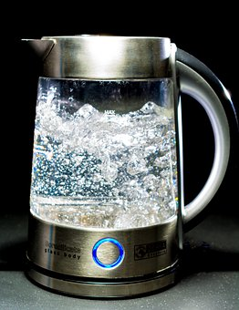
Density and the states of matter
What happens to the density of a substance during a change of state?
What happens to the density of a substance when it freezes?
What happens to the density of a substance when it boils?
Why?
Are there any exceptions?
Notes:
Suggested points:
Density changes with a change of state because the spacing between particles changes and they either gain or lose potential energy.
When a substance freezes, the particles are held more tightly together so are more tightly packed and therefore the substance has become more dense.
When a substance boils, the particles overcome the forces of attraction holding them together so can spread further apart, so the substance has become less dense.
The exception is water and ice! Students do not need to know about this in any detail yet as it is A-Level chemistry, but it is an interesting observation to share and can get students to think more deeply about linking the particle model to density.
Suggested guidance:
Talk tasks can be used in a variety of ways to suit the particular needs of the students you are teaching. Through exchanging views with others, students develop their understanding of the science beyond what could be achieved individually.
Science classrooms that successfully integrate talk have the following features:
Science talk is a regular feature of lessons and is woven into classroom activities.
Students are paired or grouped strategically by the teacher to ensure productive interaction. This might take into consideration the students’ proficiency of the English language, how encouraging they might be to peers and their attainment in the topic. It’s a good idea to consider these pairings in the class seating plan.
Students are encouraged and supported to talk, but are not forced to talk.
The teacher should take on the role of a facilitator, engaging with conversations where necessary and encouraging or steering the conversation where needed.
Students are encouraged to use the language they have to express their ideas (e.g., everyday language, imperfect English, native language), but also to incorporate science specific terminology where this is more accurate or has been taught.
6. Scientifically inaccurate ideas are not dismissed by the partner or teacher; open discussion and further investigation are relied on to help students construct ideas that support them to progress in their scientific understanding.
7. Guidelines for behaviour during talk tasks are explicit and frequently reviewed. Rules for students might be:
Listen carefully to your partner
Take turns talking.
Speak one at a time, without interrupting.
Politely agree or disagree and explain why.
Politely point out if your partner has used a scientific word incorrectly, if they have explained the science incorrectly, or if there is a more accurate way to describe something.
If confused, ask questions.
Stay focused on the discussion topic.
Respond to one another.

Slide 17
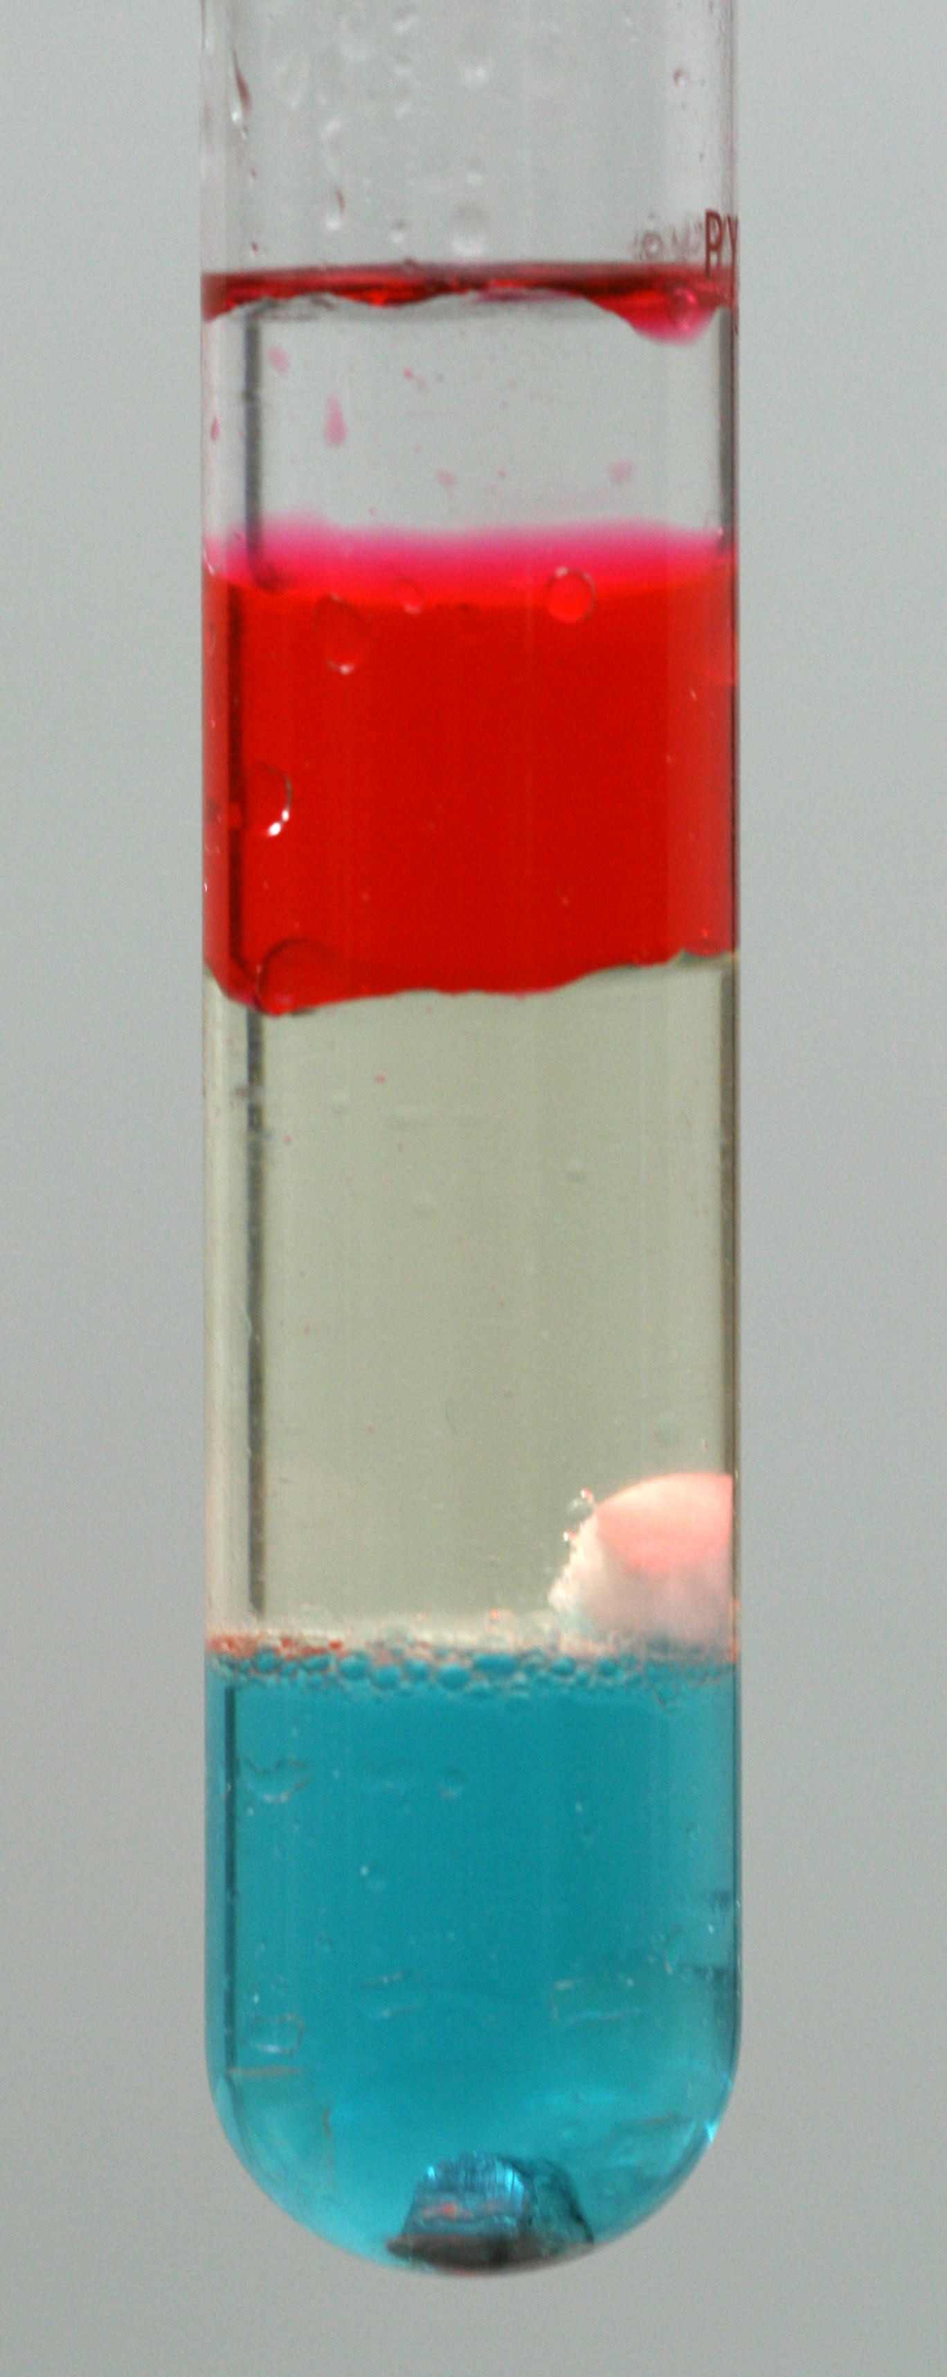
Density column
This image shows a density column. Different liquids are added to a test tube and then left to settle.
After a period of time, the different substances form layers.
By which property have these substances been separated?
Density
Which liquid is the most dense? How do you know this?
The blue liquid, as it is has settled at the bottom.
How would the particle arrangement differ between the red and blue liquids
Both are liquids, so the particle diagrams would look similar, but there would be more particles per unit volume in the blue liquid.
Notes:
Suggested guidance:
Talk tasks can be used in a variety of ways to suit the particular needs of the students you are teaching. Through exchanging views with others, students develop their understanding of the science beyond what could be achieved individually.
Science classrooms that successfully integrate talk have the following features:
Science talk is a regular feature of lessons and is woven into classroom activities.
Students are paired or grouped strategically by the teacher to ensure productive interaction. This might take into consideration the students’ proficiency of the English language, how encouraging they might be to peers and their attainment in the topic. It’s a good idea to consider these pairings in the class seating plan.
Students are encouraged and supported to talk, but are not forced to talk.
The teacher should take on the role of a facilitator, engaging with conversations where necessary and encouraging or steering the conversation where needed.
Students are encouraged to use the language they have to express their ideas (e.g., everyday language, imperfect English, native language), but also to incorporate science specific terminology where this is more accurate or has been taught.
6. Scientifically inaccurate ideas are not dismissed by the partner or teacher; open discussion and further investigation are relied on to help students construct ideas that support them to progress in their scientific understanding.
7. Guidelines for behaviour during talk tasks are explicit and frequently reviewed. Rules for students might be:
Listen carefully to your partner
Take turns talking.
Speak one at a time, without interrupting.
Politely agree or disagree and explain why.
Politely point out if your partner has used a scientific word incorrectly, if they have explained the science incorrectly, or if there is a more accurate way to describe something.
If confused, ask questions.
Stay focused on the discussion topic.
Respond to one another.
Image source:
CC@https://commons.wikimedia.org/wiki/File:Density_column.JPG

Slide 18
Drill
Define density.
Explain what density means in terms of particles.
Identify the state of matter which has the greatest density.
State the equation used to calculate density.
State the SI unit for mass.
State the SI unit for volume.
State the equation used to calculate the volume of a regularly-shaped solid.
Notes:
Purpose: This is a knowledge drill. The purpose of this is to check that the critical knowledge is secure before pupils move onto independent practice.
Suggested guidance: There are a range of ways this could be done depending on time and ability range of the class:
Mini whiteboards
As full sentences in exercise books
As short answers in exercise books
In the pupil workbook
As pair talk
As cold call

Slide 19
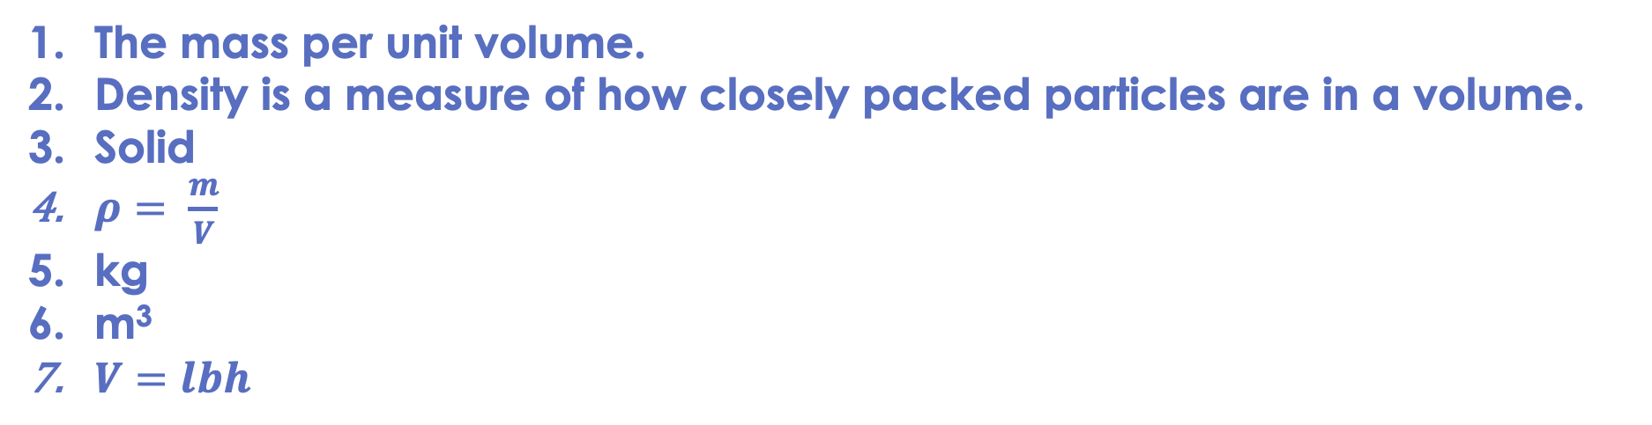
Drill answers
The mass per unit volume.
Density is a measure of how closely packed particles are in a volume.
Solid
$ρ= \frac{m}{V}$
kg
m³
$V=lbh$
Notes:
Purpose: This is a knowledge drill. The purpose of this is to check that the critical knowledge is secure before pupils move onto independent practice.
Suggested guidance: There are a range of ways this could be done depending on time and ability range of the class:
Mini whiteboards
As full sentences in exercise books
As short answers in exercise books
In the pupil workbook
As pair talk
As cold call

Slide 20
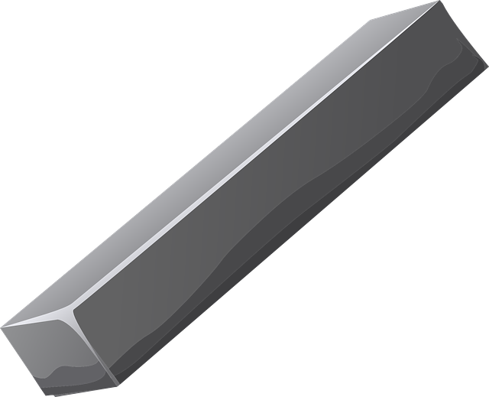
I: Calculating mass, volume and density
This block of steel has a mass of 23 550 g and a volume of 3000 cm³.
Calculate the density of the steel.
Another block of the same type of steel has a mass of 14 130 g.
Calculate its volume.
What is the equation that links density, mass and volume?
Density = Mass
Volume
Density = Mass
Volume
7.85 = 14 130
Volume
Density = 23 550
3 000
Volume = 14 130
7.85
Density = 7.85
g/cm³
Volume = 1 800
cm³
Notes:
Purpose: The I-We-You section aims to support pupils to build skills that they most commonly need when answering questions associated with this knowledge in the assessment. This section is also used to interleave other content we expect pupils to know at this stage of their education in order that they build a big picture of the science they are learning.
For the ‘I’ activity, the teacher should model how to answer the question. They can do this by narrating their thinking process aloud, and making links to learning earlier in the lesson explicit.
For the ‘we’ activity, the teacher and students work though a similar example together, in order to prepare students to be able to answer a similar question independently.
Opportunities for the ‘you’ activity – independent practise – occur in the activity portion of the lesson once the student is secure enough to process independently.

Slide 21

We: Calculating mass, volume and density
This snooker ball has a mass of 160 g and a volume of 92 cm³.
Calculate the density of the ball.
A different manufacturer makes snooker balls with the same density.
Calculate the mass of a ball that has a volume of 98 cm³.
What is the equation that links density, mass and volume?
Density = Mass
Volume
Density = Mass
Volume
1.74 = Mass
98
Density = 160
92
Mass = 170.52
g
Density = 1.74
g/cm³
Notes:
Purpose: The I-We-You section aims to support pupils to build skills that they most commonly need when answering questions associated with this knowledge in the assessment. This section is also used to interleave other content we expect pupils to know at this stage of their education in order that they build a big picture of the science they are learning.
For the ‘I’ activity, the teacher should model how to answer the question. They can do this by narrating their thinking process aloud, and making links to learning earlier in the lesson explicit.
For the ‘we’ activity, the teacher and students work though a similar example together, in order to prepare students to be able to answer a similar question independently.
Opportunities for the ‘you’ activity – independent practise – occur in the activity portion of the lesson once the student is secure enough to process independently.

Slide 22
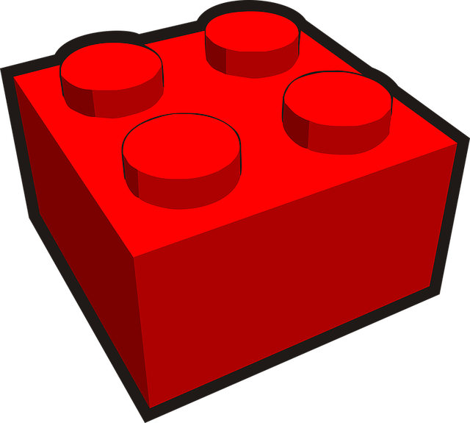
You: Calculating mass, volume and density
This plastic building block has a volume of 2.2 cm³. Its mass is 1.25 g.
Calculate the density of the block.
The same material is used to make a brick that is double the volume.
Calculate the mass of the bigger brick.
What is the equation that links density, mass and volume?
Density = Mass
Volume
Density = Mass
Volume
Density = 1.25
2.2
0.57 = Mass
4.4
Density = 0.57
g/cm³
Mass = 2.5
g
Notes:
Purpose: The I-We-You section aims to support pupils to build skills that they most commonly need when answering questions associated with this knowledge in the assessment. This section is also used to interleave other content we expect pupils to know at this stage of their education in order that they build a big picture of the science they are learning.
For the ‘I’ activity, the teacher should model how to answer the question. They can do this by narrating their thinking process aloud, and making links to learning earlier in the lesson explicit.
For the ‘we’ activity, the teacher and students work though a similar example together, in order to prepare students to be able to answer a similar question independently.
Opportunities for the ‘you’ activity – independent practise – occur in the activity portion of the lesson once the student is secure enough to process independently.

Slide 23
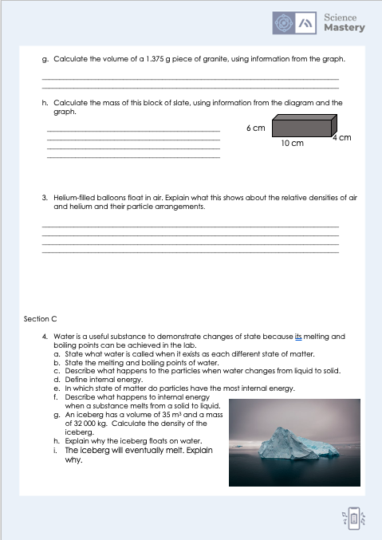
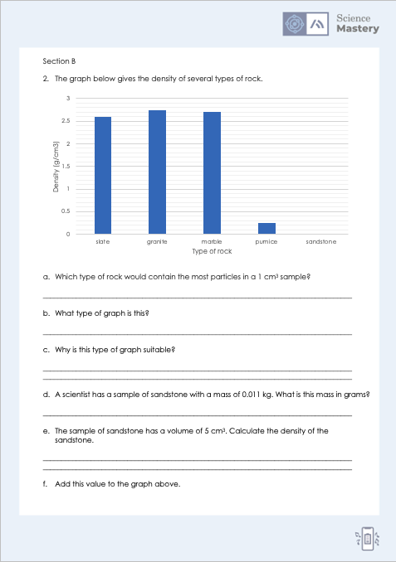
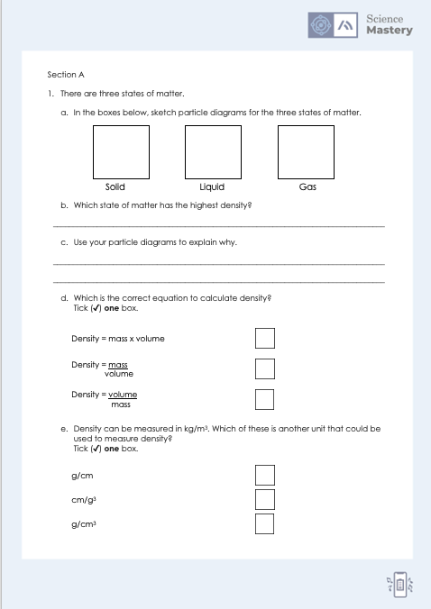
Activity

Slide 24
Answers
Solid
Liquid
Gas
1b. Solid
1c. There are the most particles in a given volume, the particles are packed most closely together.
1d. Density = mass
volume
1e. g/cm³

Slide 25
Answers
2a. Granite
2b. Bar graph
2c. Because the data is categorical/discrete.
2d. 11 g
2e. Density = mass = 11 g = 2.2 g/cm³
volume 5 cm³

Slide 26
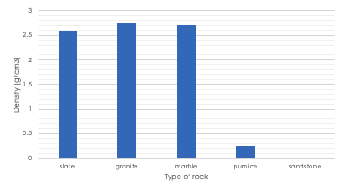
Answers

Slide 27
Answers
2g. Density = mass
volume
2.75 g/cm³ = 1.375 g
volume
Volume = 0.5 cm³
3. Helium is less dense than air. This means that its particles are more spread out and there are fewer particles (mass) per unit volume.
2h. Density = mass
volume
Volume = 10 x 6 x 4 = 240 cm³
2.6 g/cm³ = mass
240 cm³
Mass = 624 g

Slide 28
Answers
4a. Solid: ice, liquid: water, gas: steam
4b. Melting point = 0 ºC, boiling point = 100 ºC
4c. The particles are able to move more and flow past each other.
4d. The total amount of kinetic and potential energy of all the particles in a system.
4e. Gas
4f. Internal energy increases
4h. The density of the iceberg is lower than the density of the water.
4g. Density = mass
volume
Density = 32 000 kg
35 m³
Density = 914.29 kg/m³
4i. There is a temperature difference between the ice and the water so energy is transferred (from ice to water) until they reach equilibrium.

Slide 29
Answer the questions below.
Which statement is correct?
A. Density is a measure of how heavy the particles in a substance are
B. Density is a measure of how many particles are in a given volume
C. Density is a measure of how many particles there are in a substance
✓
2. Two cubes have the same volume but different masses. Which statement is correct?
A. The cube with the least mass is the most dense
B. Both the cubes have the same density
C. The cube with the greatest mass is the most dense
✓
3. What is the mass of a block of iron that has a volume of 1 m³? Iron has a density of 7800 kg/m³.
A. 7800 kg
B. 7.8 kg
C. 0.000128 kg
✓
Notes:
Q1. Answer: B
If students answer A, they have confused density with weight. If students answer C, they have confused density with mass. To fix-it, review the definitions of density, mass, volume and weight.
Q2. Answer: C
If students answer A or B, they are not clear on the relationship between mass, volume and density. To fix-it, use numbers to show students how two objects can have the same volume but different masses and then ask them to explain this in terms of the relationship between mass, volume and density.
Q3. Answer: A
If students answer B, they have made a mistake and assumed this mass needs to be converted. If students answer C, they have divided volume by density. To fix-it, give students further practice questions, mixing between calculating mass, volume and density.

Slide 30
Lesson P4.1.2
What was good about this lesson? | What can we do to improve this lesson?
Send us your feedback by clicking this link. Thank you!

